Slide 1

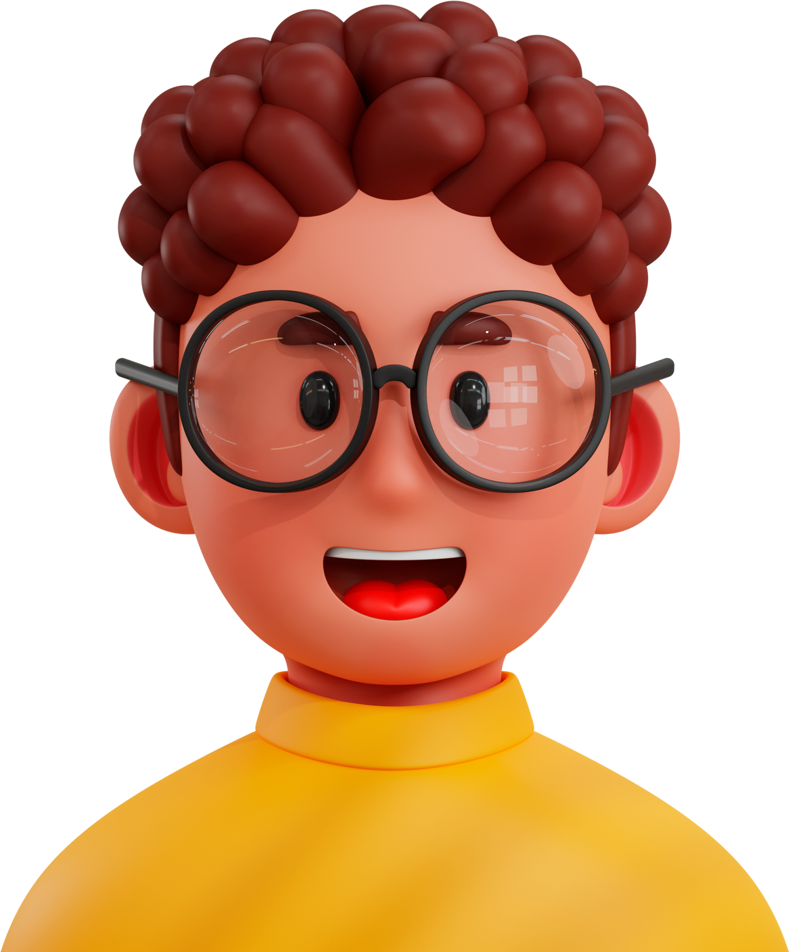

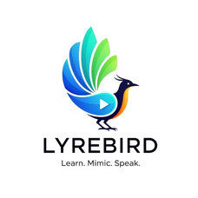
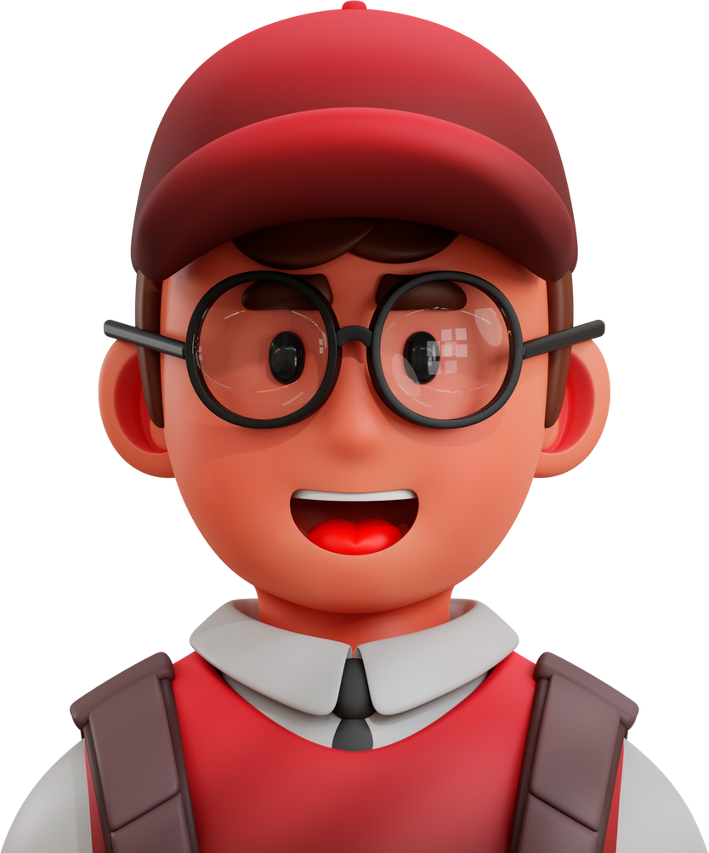





COMSOC HACKX
CODE | INNOVATE | BUILD
LyreBird
Learn. Mimic. Speak.
TEAM AWW
Gauraangi Praakash
Aditya Singh
Vishal Sarup Mathur
github.com/dinasquare/LyreBird

Slide 2

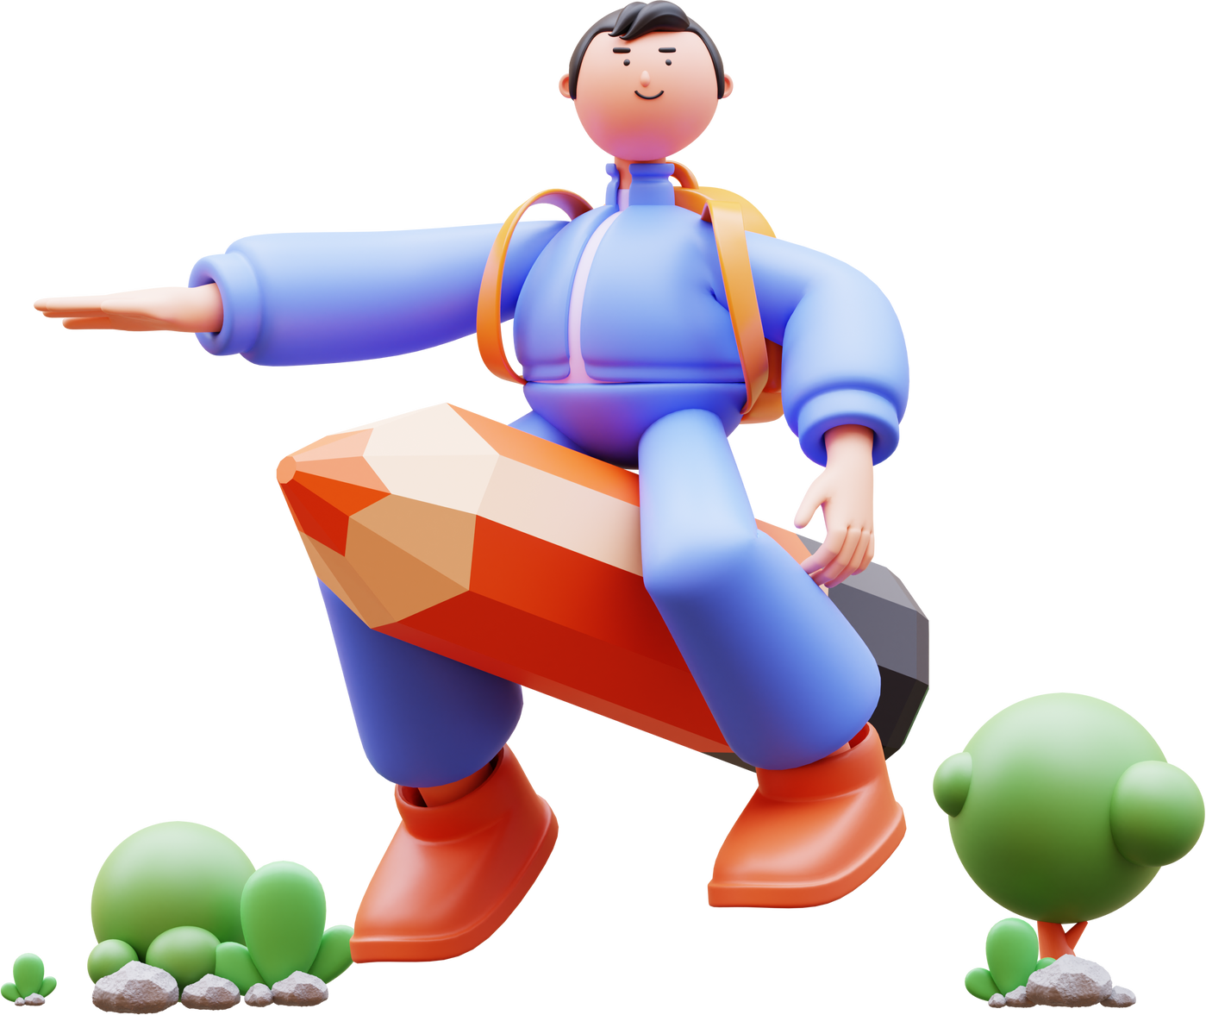



Team:AWW
Problem Statement
Language learning in EdTech
Traditional methods can be boring and don't stick.
Traditional language learning, often relying on textbooks and repetitive drills, is frequently boring and fails to create lasting knowledge.
Tough & expensive to find native speakers for practice.
Finding and scheduling time with native speakers for genuine practice is both difficult and costly.
Current language apps lack true personalization and conversational depth.
Many current language-learning applications fall short, offering a monotonous experience that lacks true personalization and the depth of real conversation.
They are not interactive and are monotonous
Existing methods, including many apps, are not truly interactive, leading to a passive and monotonous learning experience.

Slide 3


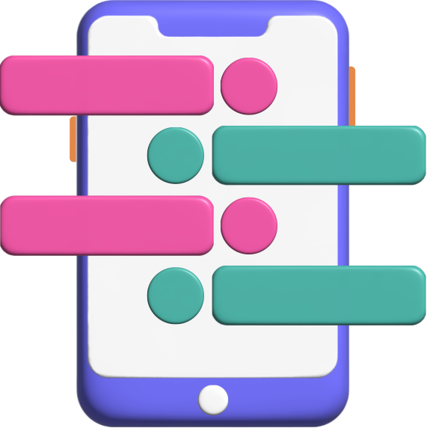
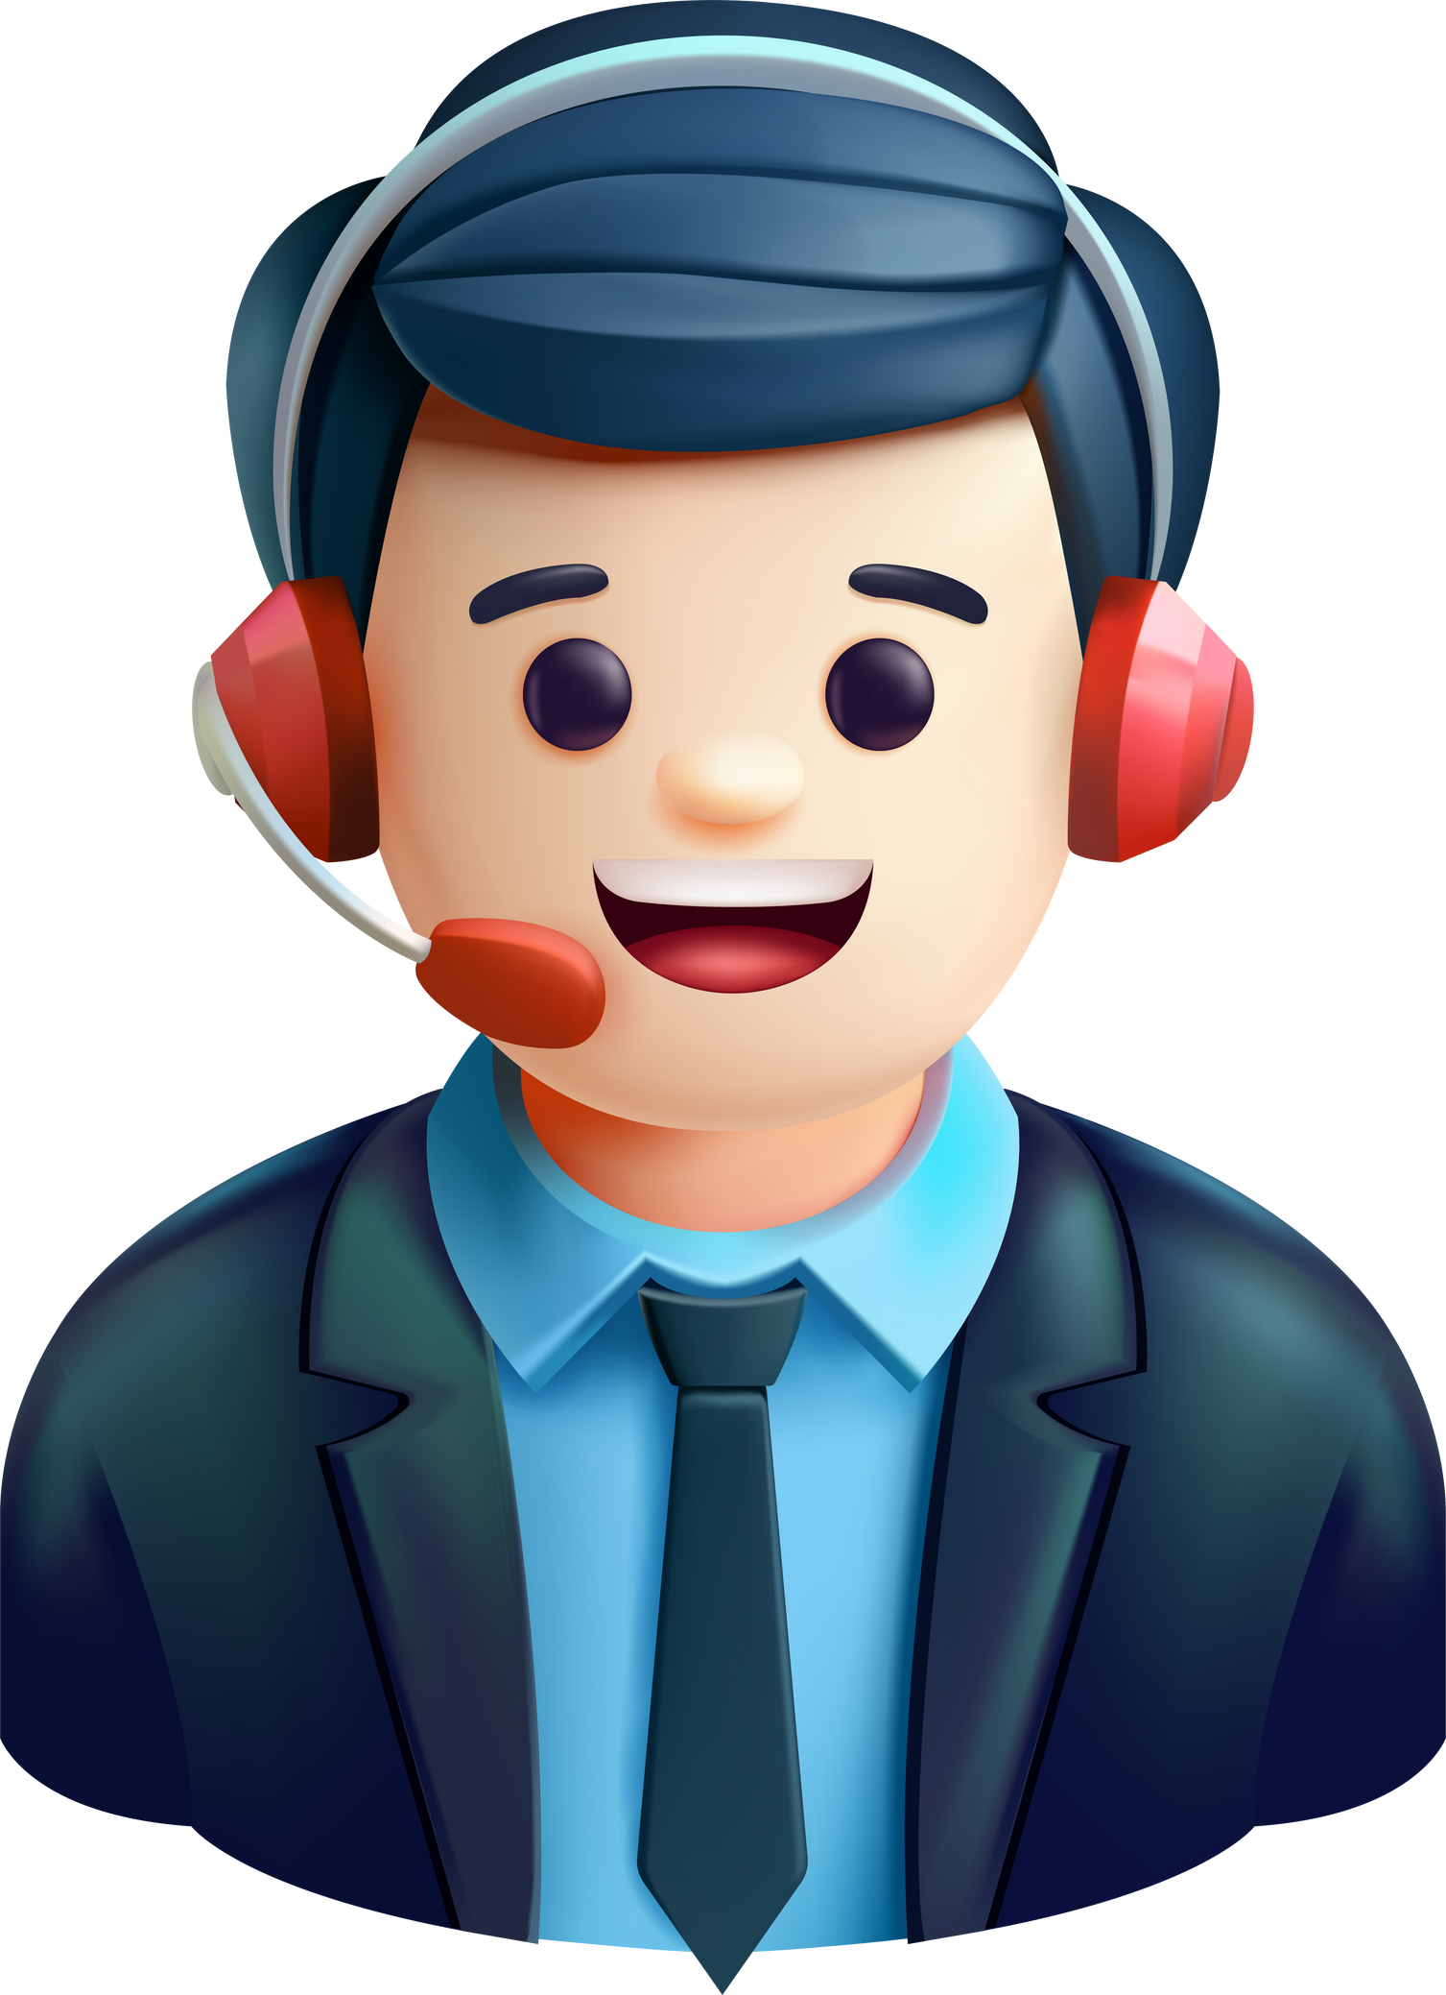
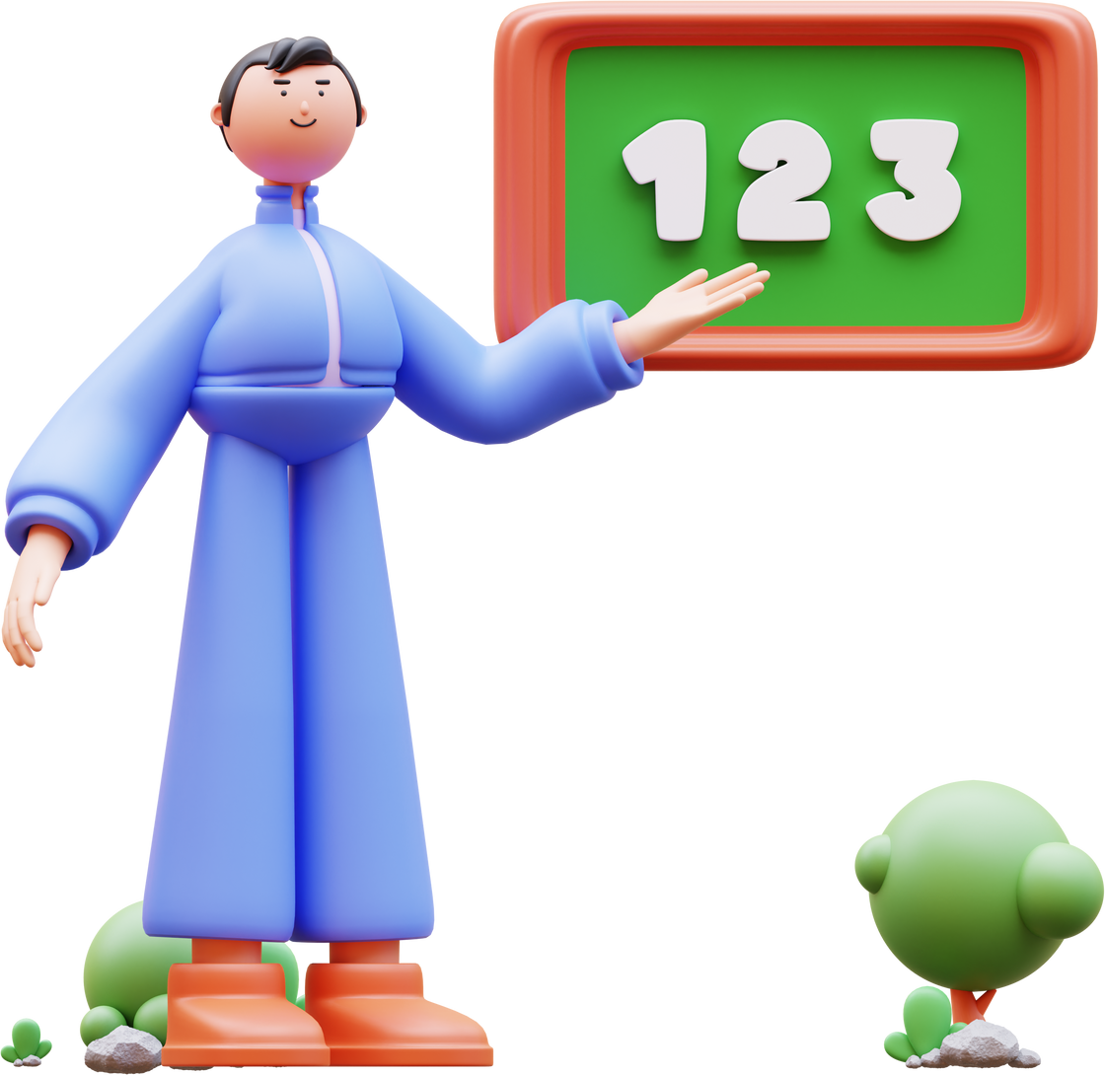




Team:AWW
Our Solution
Immersive
AI Tutor
Introducing Lyebird: Learn a Language by Chatting
An immersive and interactive language learning experience.
Engage in natural, flowing conversations with our AI-powered chatbot.
Learn anytime, anywhere, at a pace that suits you.
Learn through natural, real-world conversations to build confidence and fluency
A personalized, on-demand AI tutor that adapts to your learning style and provides instant feedback
Quizzes and Flashcards
Better Tracking
Reinforce new vocabulary and grammar with fun, integrated quizzes and flashcards
See your progress with detailed analytics that highlight your strengths and areas for improvement
Our platform delivers a comprehensive learning solution by combining an immersive environment, a personalized AI tutor, dynamic quizzes and flashcards, and superior progress tracking.

Slide 4



Team:AWW
Why choose our Platform
Introducing Lyebird: Learn a Language by Chatting
An immersive and interactive language learning experience.
Engage in natural, flowing conversations with our AI-powered chatbot.
Learn anytime, anywhere, at a pace that suits you.
Chatbot
Events & Flashcards
Your own AI Tutor - RAG Based Chatbot to converse with and learn new things.
Interactive flashcards and quizzes to help make learning fun.
LOGIN
3D Model
Clerk authentication for easy login/signup to your own personalized dashboard.
Interactive 3D Models to give you that “personal feel” of being taught

Slide 5




Team:AWW
OUR UNIQUE SELLING PROPOSITIONS
Immersive 3D Experience
Hyper-Personalized Learning
Dynamic Learning
makes learning feel like a genuine conversation.
focuses on the interactive, non-linear aspect

Slide 6
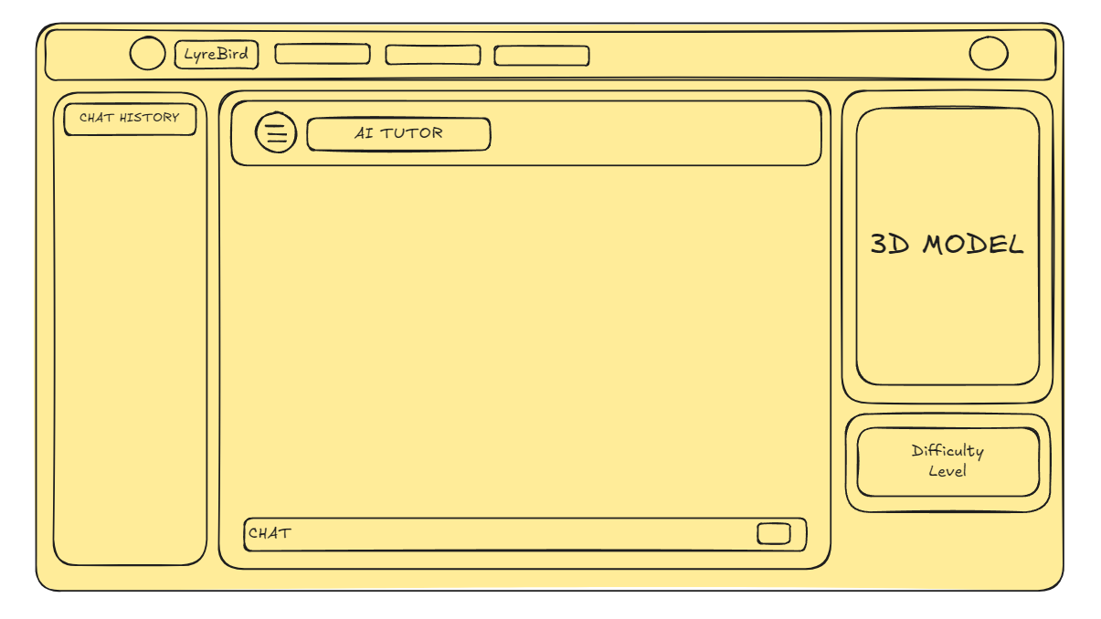
Team:AWW

Slide 7


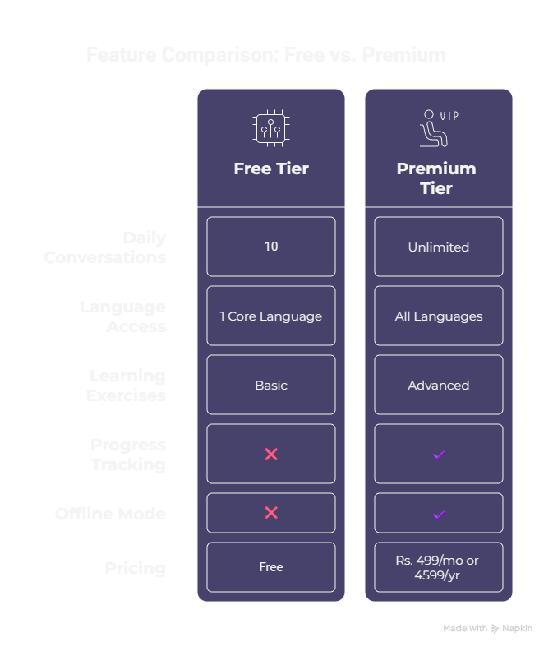
Team:AWW
Our Business Model
Freemium Model:
Free Tier: Enjoy limited daily conversations and access to basic features.
Premium Subscription: Unlock unlimited access, advanced features, and an offline mode for learning on the go.
B2B Partnerships:
We plan to collaborate with schools and corporations to offer LyreBird to their students and employees.

Slide 8









Team:AWW
MEET THE TEAM
Gauraangi
Aditya
Vishal
www.linkedin.com/in/gauraangi
dinasquare.vercel.app
www.linkedin.com/in/adityasingh42
velcorum.vercel.app
www.linkedin.com/in/vishal-mathur25

Slide 9











Team:AWW

